Slide 1
IoT for Smart Engine Health Monitoring System
A dive into the IoT world

Slide 2
Internet of Things
The Internet of Things phenomenon started in 1960 and represents a complex system composed of numerous devices and technologies that are linked together.
This network of interconnected gadgets facilitates the communication between the devices and the Cloud.

Slide 3

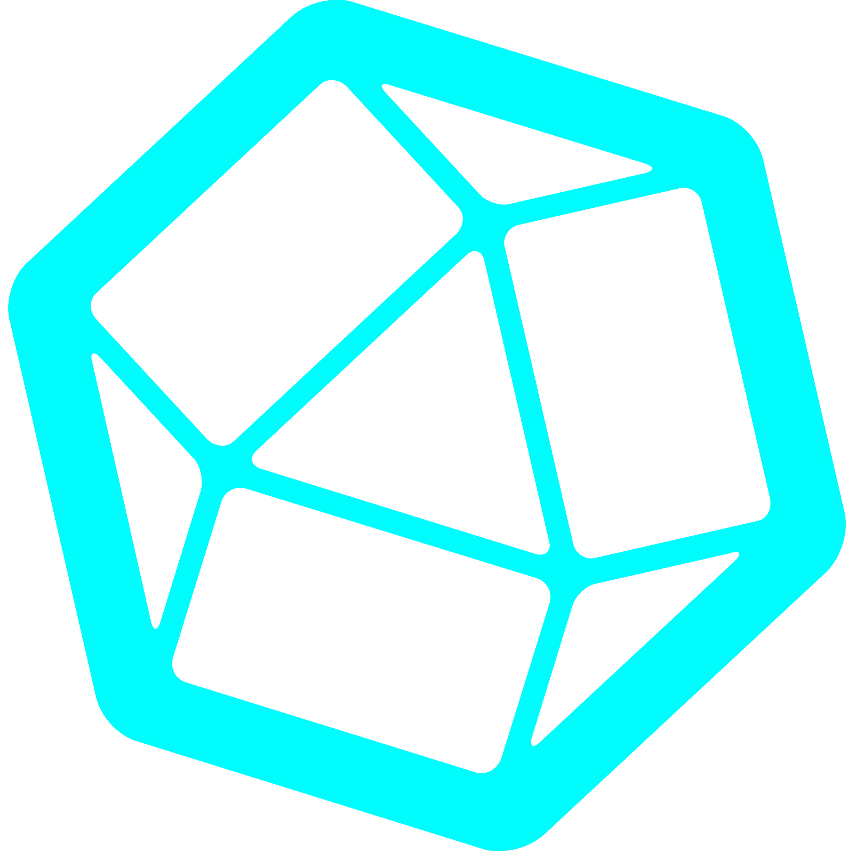


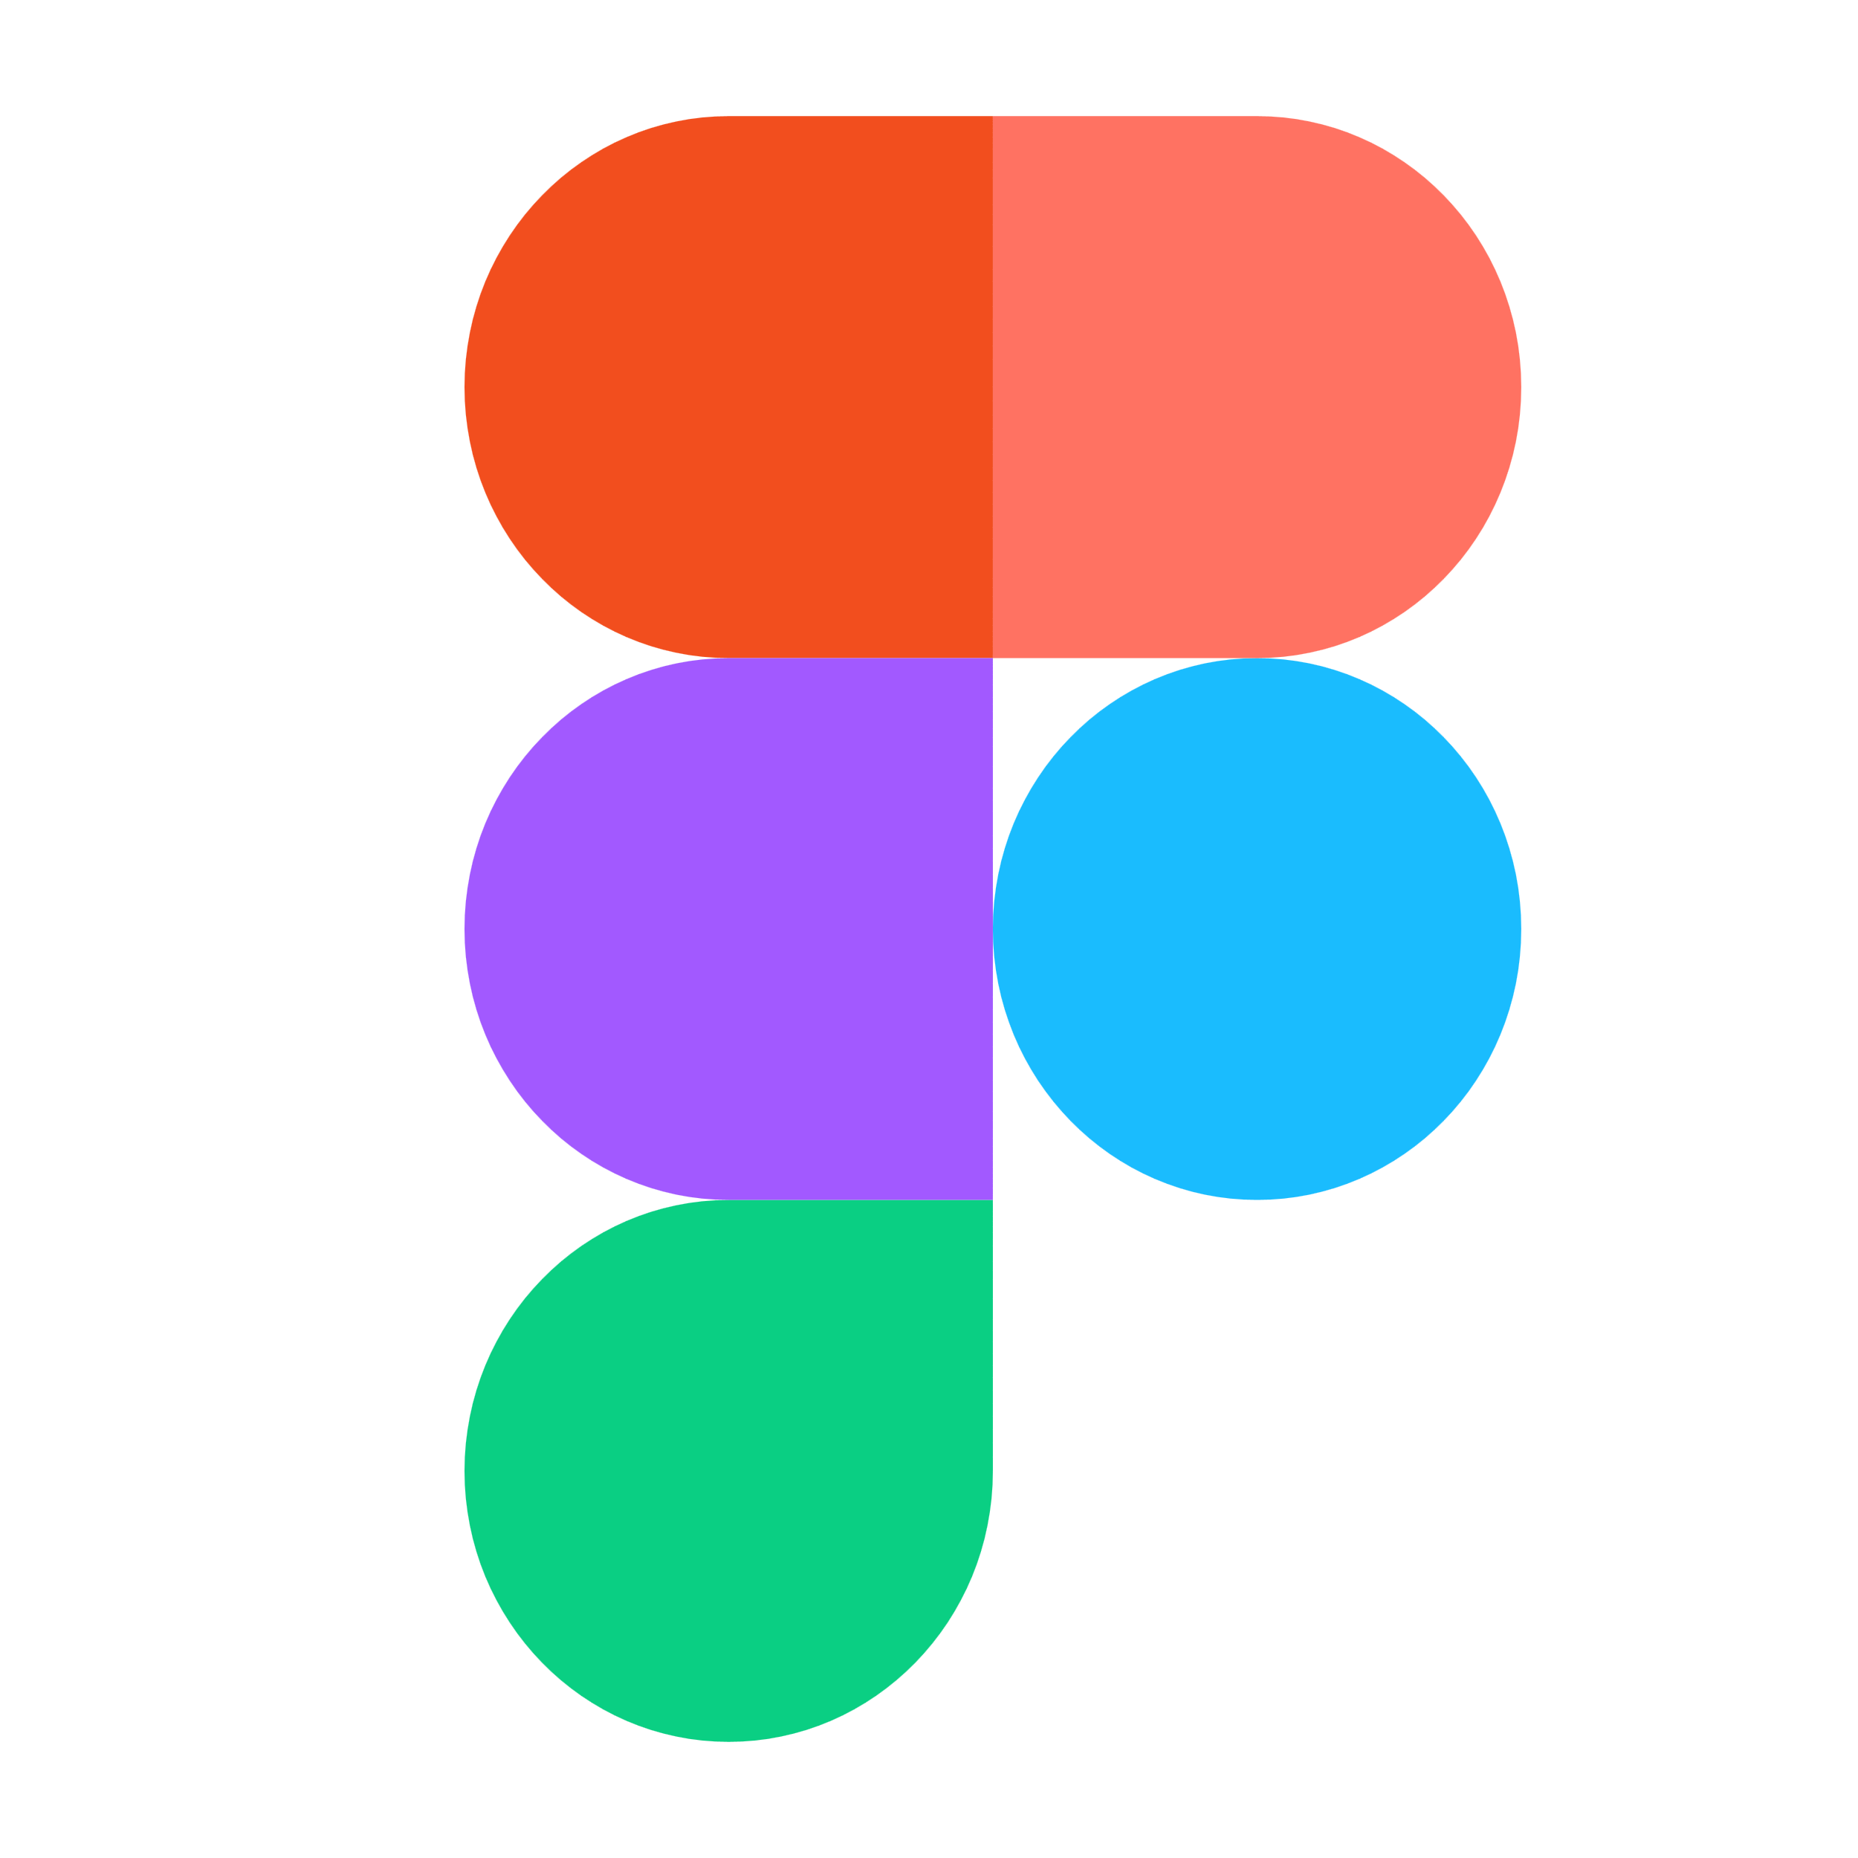

Technologies
Java
InfluxDB
Node-Red
Figma
general-purpose, class-based object-oriented
programming language
open-source database optimized for live data inputs
Android Studio
open-source software platform for creating Android applications
open-source, cross-platform, interface programming tool
SQLite
Cloud-based platform used for graphic design
open-source, relational database used for storing information

Slide 4
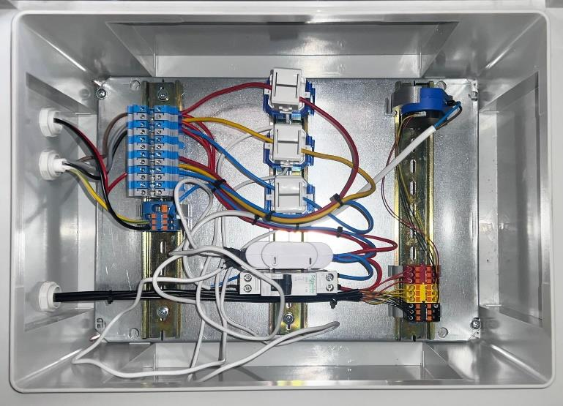
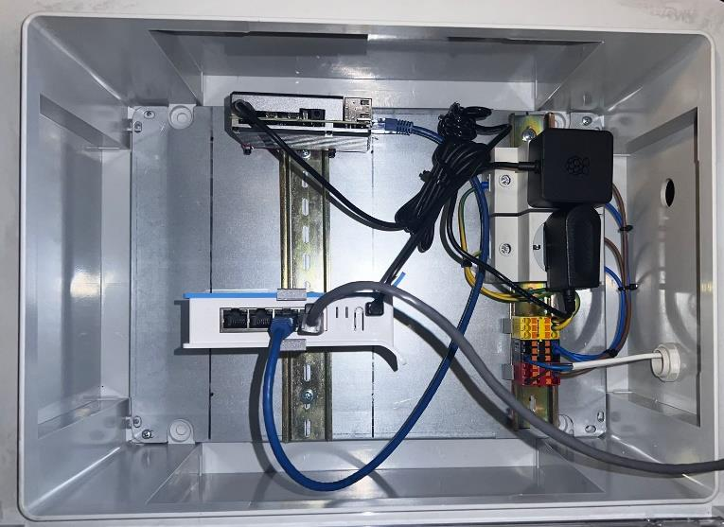
Hardware
Raspberry PI 4
Wi-Fi router
power supply
connectors
electrical sensors
temperature reader
switch

Slide 5
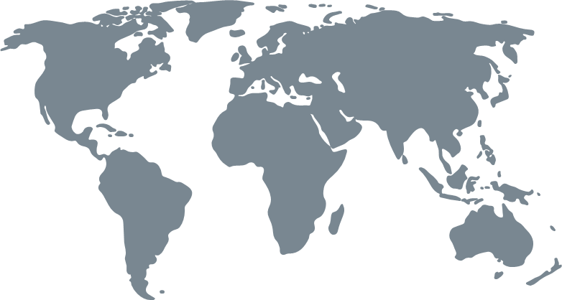
Conclusions - Solving problems
This project provided a solution to increase the presence of Internet of Things in Romania by:
Providing an easy to integrate example
Cutting the costs of implementation
Creating a free software application for monitoring the state of the equipment
Creating a suitable environment for predictive and preventive maintenance
Those solutions will boost the digitalization process and will enable small companies to reduce overall production costs.

